Slide 1
NAME: KATHIRAVAN T NM.ID:au730321104021 REG.NO:730321104021 DEPT:BE-CSE YEAR:3rd-YEAR COLLEGE: BUILDERS ENGNIEERING COLLEGE
3/21/2024 Annual Review

Slide 2
PEDESTRIAN DETECTION
Pedestrian detection refers to the process of identifying and locating pedestrians within images or videos, typically within a computer vision context. It's a crucial task in various applications such as autonomous driving, surveillance systems, and human-computer interaction. Here's a brief overview of the key aspects of pedestrian detection
3/21/2024 Annual Review

Slide 3


AGENDA
Project Planning and Preparation
Data Collection and Preparation
Algorithm Selection and Development
Model Training and Validation
Evaluation and Testing
Optimization and Fine-Tuning
Deployment and Integration
Review and Feedback
Maintenance and Updates
3/21/2024 Annual Review

Slide 4

PROBLEM STATEMENT
Background: Pedestrian detection is a critical component of advanced driver assistance systems (ADAS) and autonomous vehicles to ensure the safety of pedestrians and other road users. In urban environments, the presence of pedestrians in complex scenes with varying lighting conditions, occlusions, and cluttered backgrounds poses significant challenges for detection algorithms.
Objective: The objective of this project is to develop an accurate and robust pedestrian detection system capable of detecting pedestrians in urban environments captured by onboard cameras of autonomous vehicles. The system should operate in real-time with low latency while maintaining high precision and recall rates.
Key Challenges:
Expected Deliverables
Stakeholders
Timeline
Budget
Conclusion
3/21/2024 Annual Review

Slide 5

PROJECT OVERVIEW
A pedestrian detection project involves the development of algorithms and systems capable of identifying and locating pedestrians within images or video frames. This technology is widely used in various applications, including autonomous vehicles, surveillance systems, and advanced driver assistance systems (ADAS)
Problem Definition
Data Collection:
Data Preprocessing
Feature Extraction
Model Training
Model Evaluation
Integration
Testing and Validation
Deployment
Maintenance and Updates
3/21/2024 Annual Review

Slide 6

WHO ARE THE END USERS?
Automotive Industry:
Autonomous Vehicle Manufacturers: Companies developing self-driving cars utilize pedestrian detection systems to ensure safe navigation and avoid collisions with pedestrians.
2. Surveillance and Security Companies:
Security System Integrators: Companies that provide surveillance solutions for public spaces, airports, malls, and other high-traffic areas utilize pedestrian detection for security and monitoring purposes.
3. Urban Planning and Transportation Authorities:
City Planners: Urban planners and transportation authorities may use pedestrian detection systems to analyze pedestrian traffic patterns, optimize street designs, and enhance pedestrian safety in urban environments.
4. Retail and Commercial Establishments:
Retailers: Stores and shopping centers may employ pedestrian detection systems for crowd management, customer analytics, and security purposes.
5. Infrastructure and Construction Companies:
Construction Site Managers: Pedestrian detection systems can enhance safety at construction sites by alerting workers to the presence of pedestrians in hazardous areas.
3/21/2024 Annual Review

Slide 7

YOUR SOLUTION AND ITS VALUE PROPOSITION
KEY COMPONENTS:
Advanced Deep Learning Model.
Real-Time Processing:.
Robust Performance:
Customizable Integration:
Scalability
VALUE PROPOSITION:
Enhanced Safety:
Improved Efficiency:
Cost Savings
Data Insights
Future-Proof Technology:
3/21/2024 Annual Review

Slide 8
THE WOW IN YOUR SOLUTION
Unprecedented Accuracy:
Ultra-Fast Processing:
Adaptive Learning Capabilities
Multi-Modal Sensing Fusion:.
Intelligent Contextual Understanding:.
Seamless Integration and Scalability:
Privacy-Preserving Design:
3/21/2024 Annual Review
8

Slide 9
MODELLING
Data Collection
Data Preprocessing
Feature Extraction
Model Selection
Model Training
Model Evaluation
Testing and Validation
Deployment
Monitoring and Maintenance
3/21/2024 Annual Review
9

Slide 10
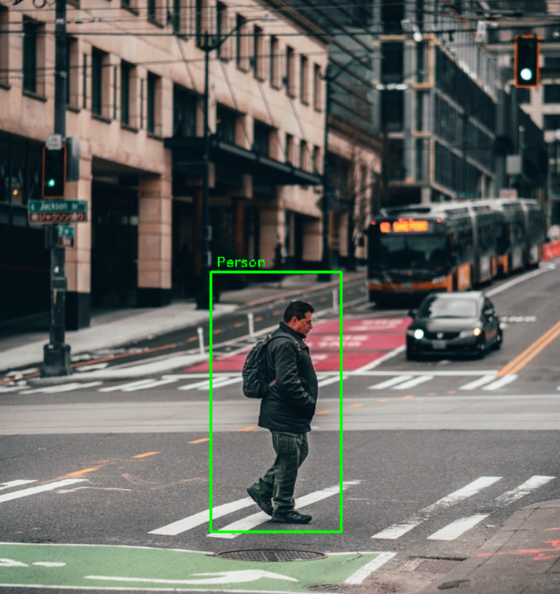
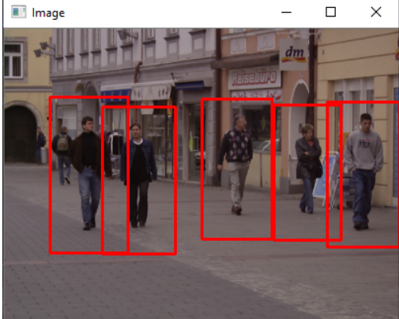
RESULTS
Demo Link
3/21/2024 Annual Review
10

